Slide 1
PHOTO EDITING - Development
CSE 611 – MS Project Development
Professor – Jinjun Xiong

Slide 2
TEAM MEMBERS
Pavana Lakshmi Venugopal
Saad Ahmed
Taraka Rohit Adusumilli
Ayesha Humaera

Slide 3
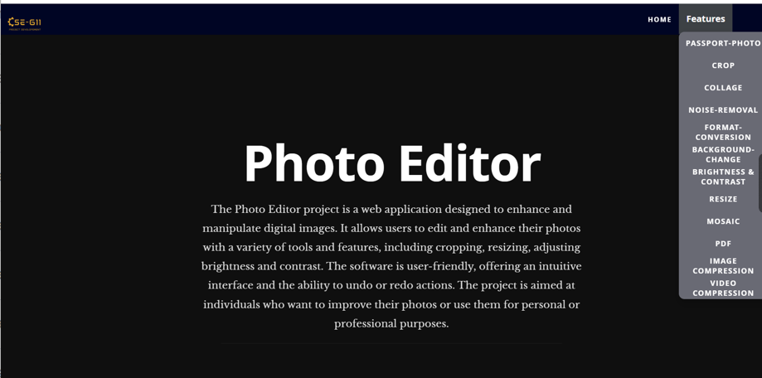
Updated Home Page

Slide 4
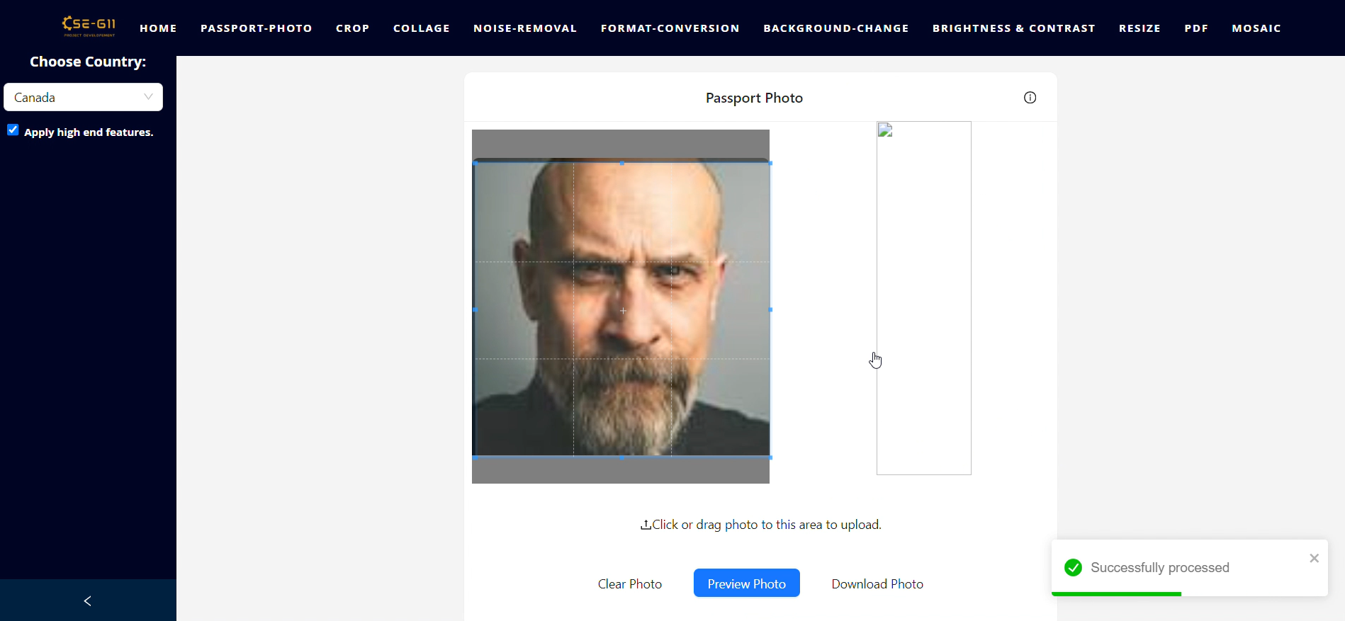
Apply high end features - Before fix

Slide 5
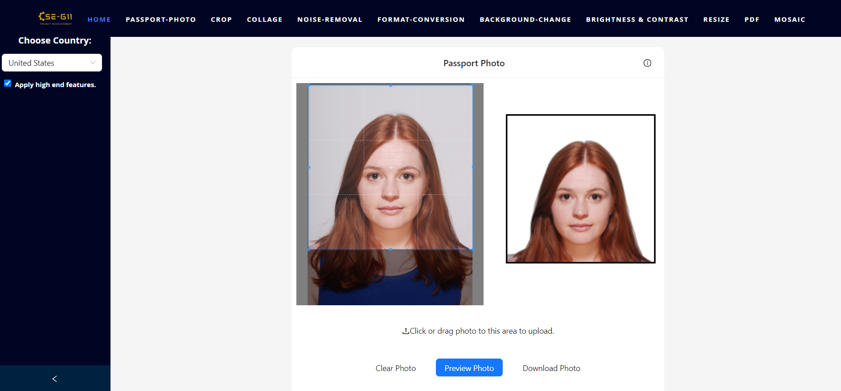
Apply high end features - After fix

Slide 6
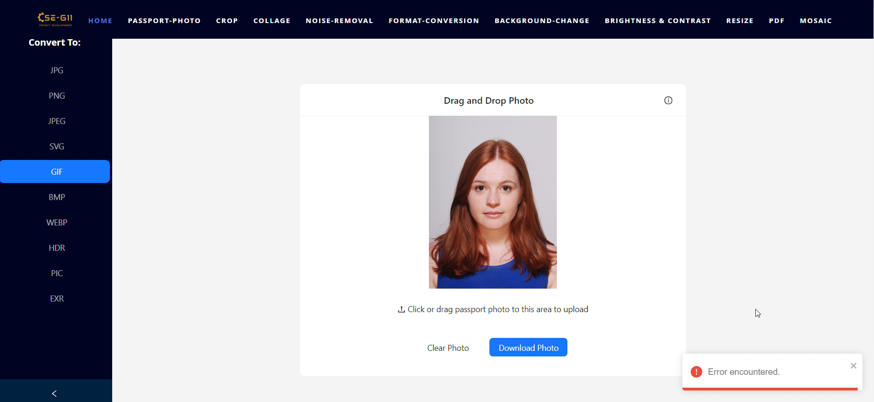
Format Conversion- Before fix

Slide 7
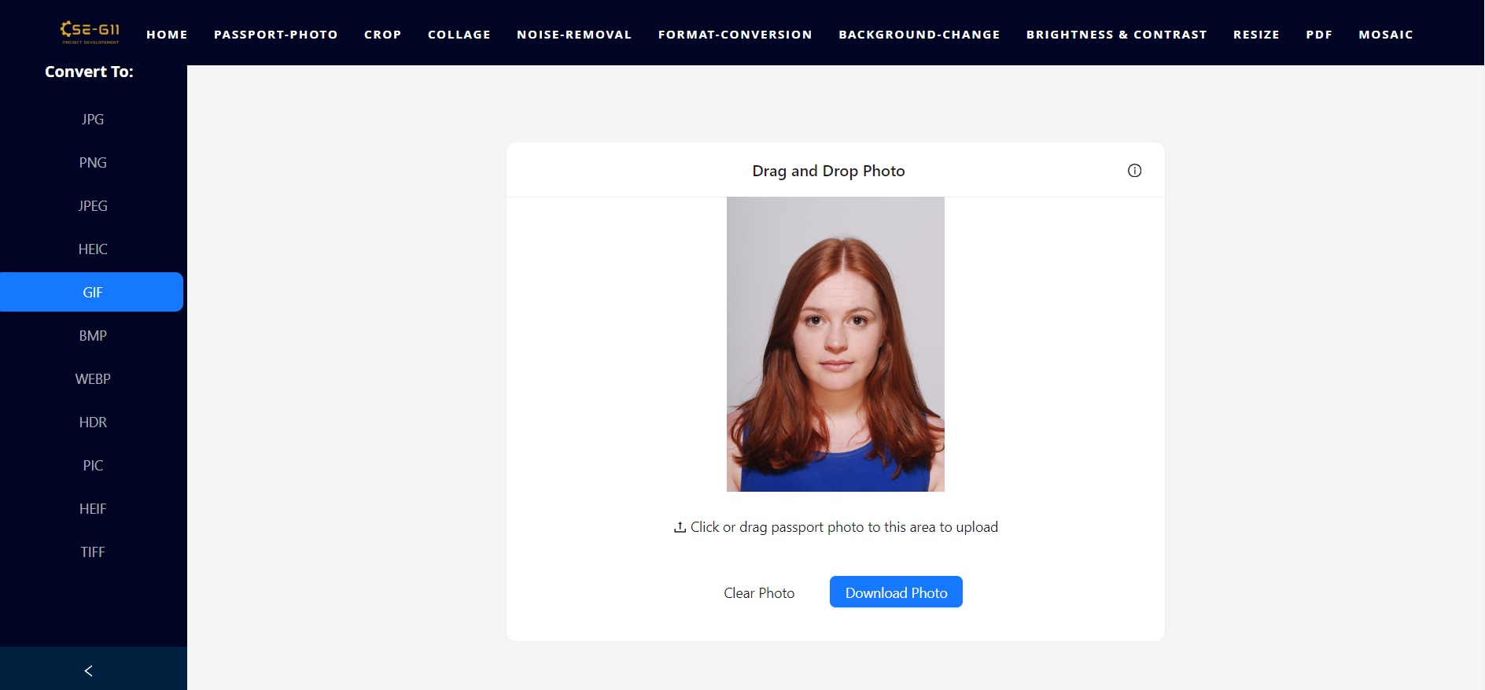
Format Conversion - After fix

Slide 8
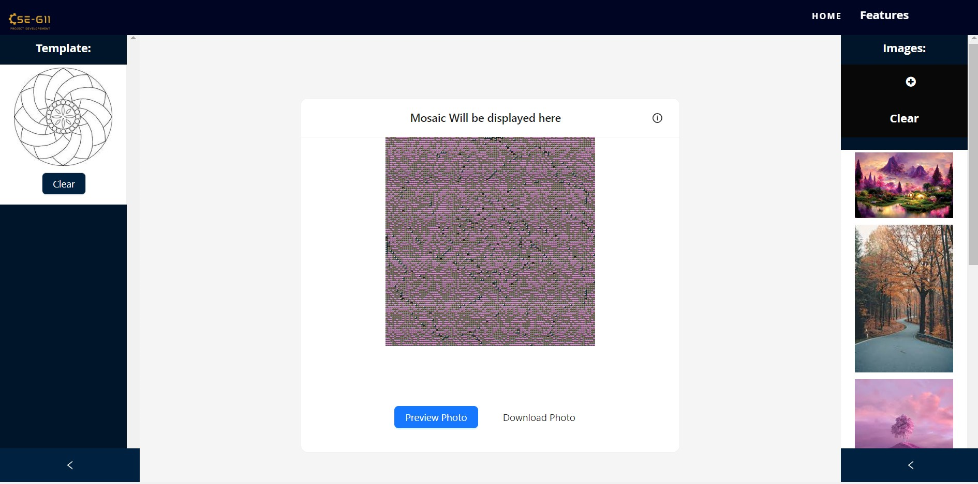
Mosaic Tool - Before Fix

Slide 9
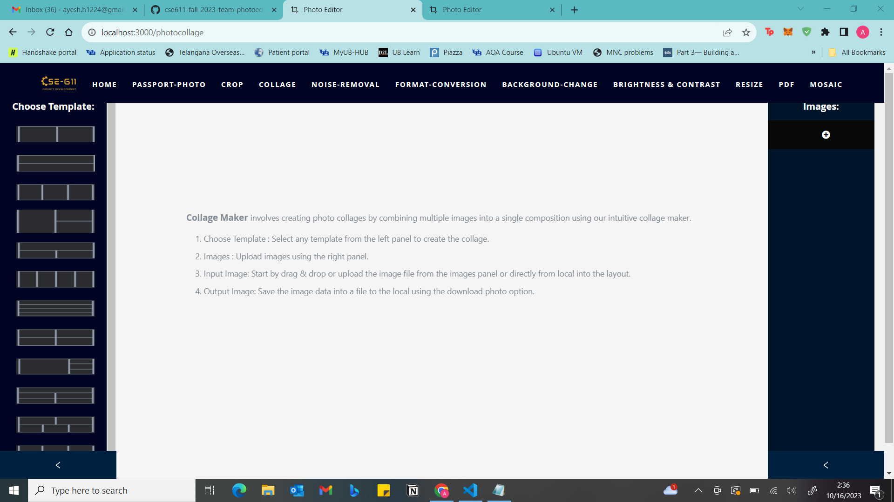
Photo Collage Tool - Before Fix

Slide 10
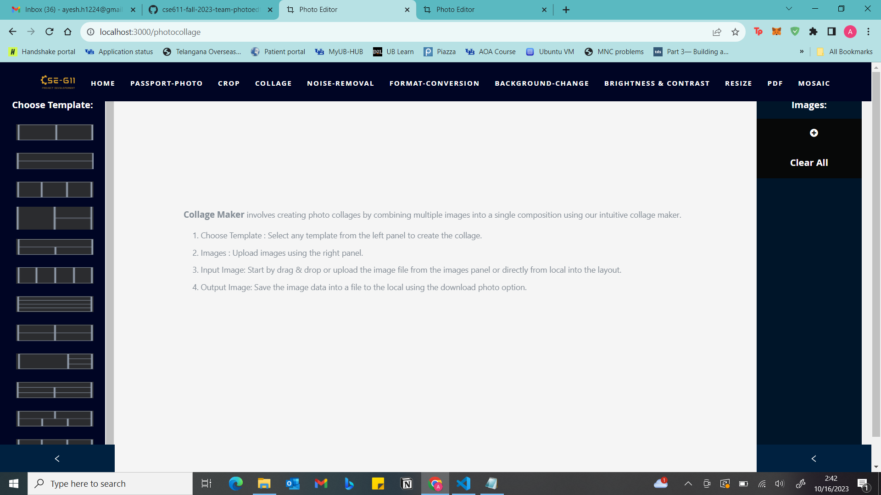
Photo Collage Tool - After Fix

Slide 11
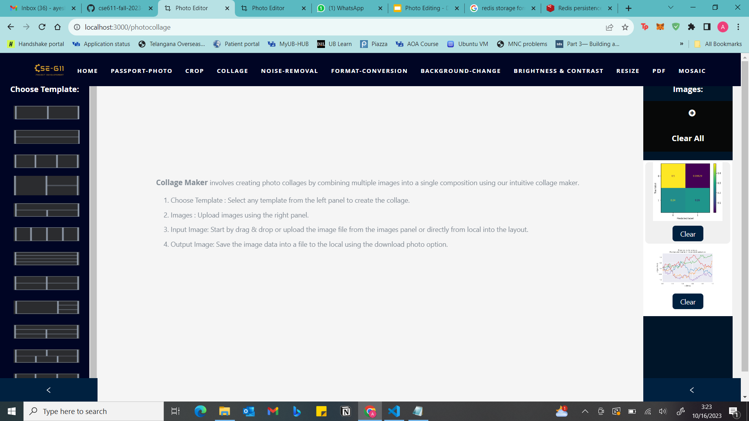
Photo Collage Tool - After Fix (Adding a delete button for individual images)

Slide 12
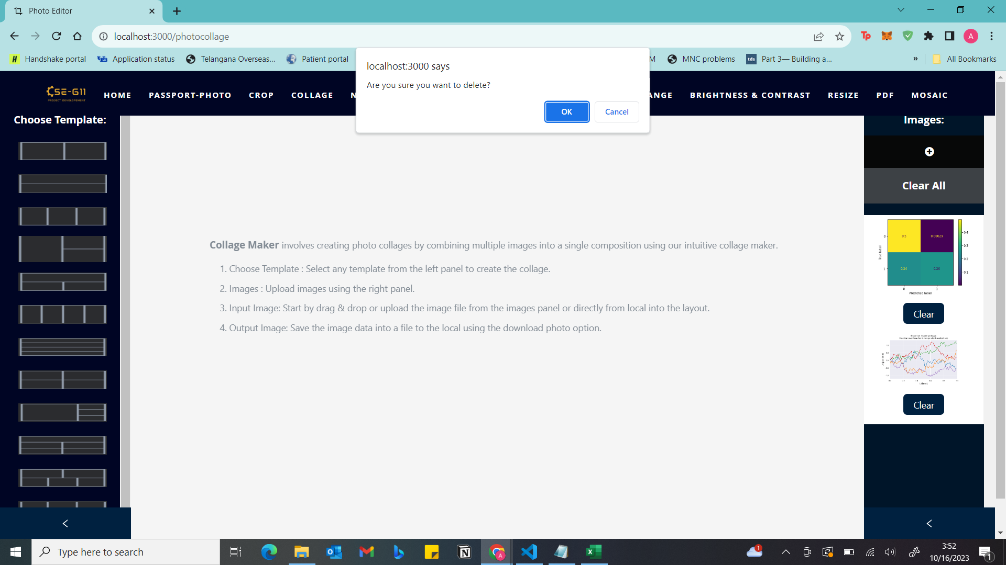
Photo Collage Tool - After Fix (Adding a pop-up asking for confirmation before deleting)

Slide 13
OpenCV to Implement Image Compression
Approach:
Using cv2 library in OpenCV to implement image compression.
Benefits:
The cv2 library provides a variety of image compression algorithms, including JPEG, PNG, and WebP.
The cv2 library can be used to compress images without sacrificing quality.
The cv2 library is optimized for speed, making it a good choice for real-time applications.

Slide 14
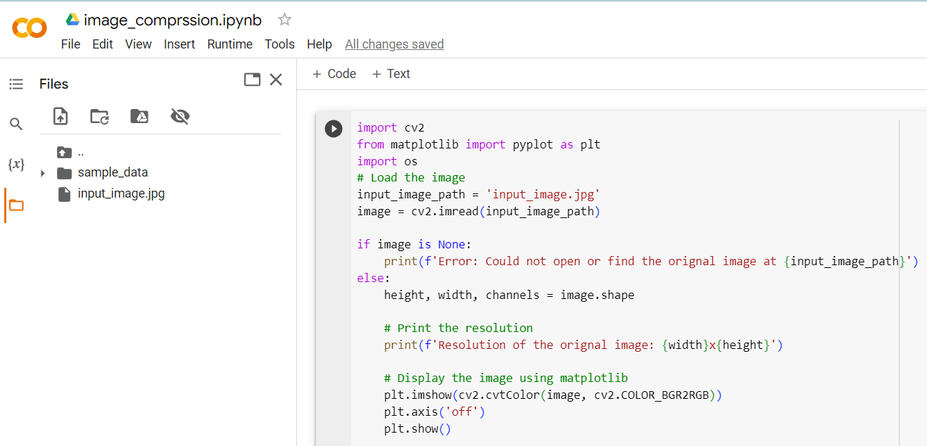
A demo to show effective working of cv2:

Slide 15
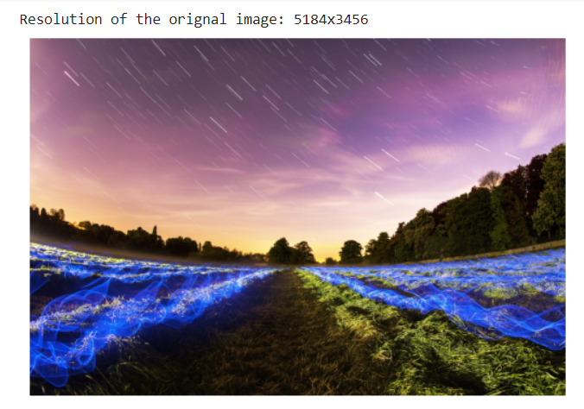
A demo to show effective working of cv2:

Slide 16
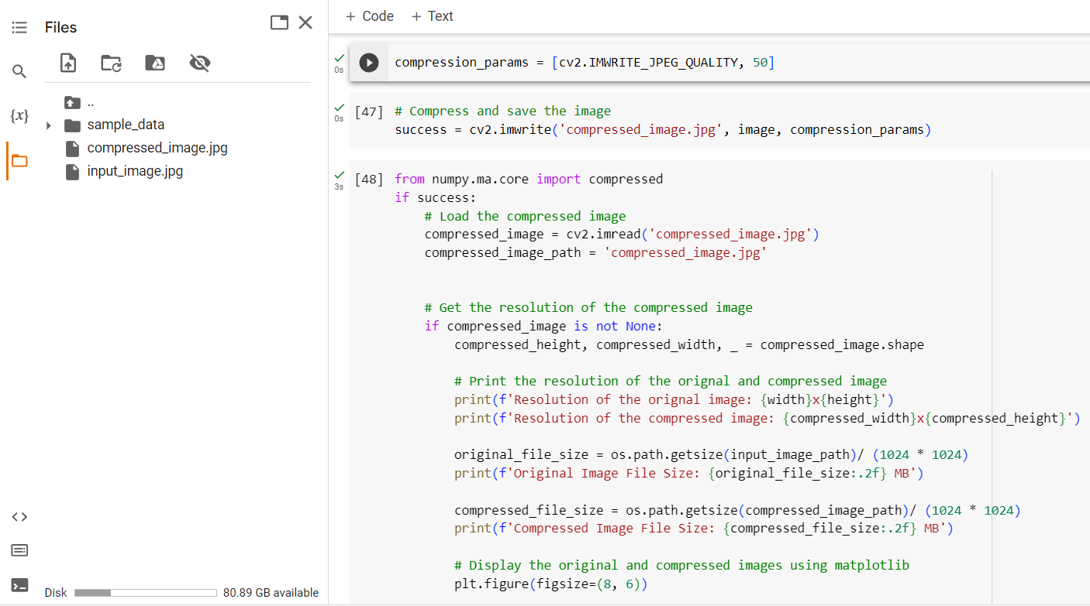
A demo to show effective working of cv2:
Note: #50 is the quality parameter (0-100), higher is better quality.

Slide 17
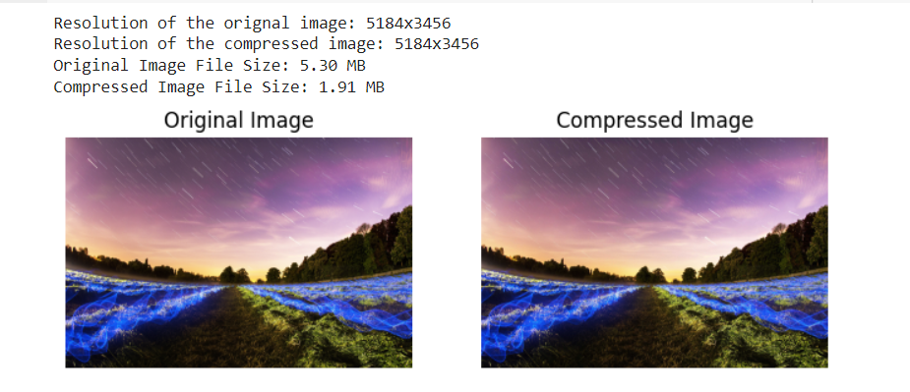
A demo to show effective working of cv2:

Slide 18
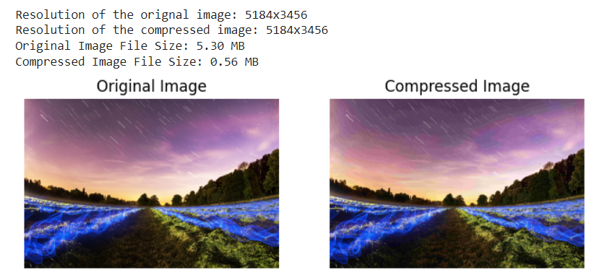
A demo to show effective working of cv2:
When the quality parameter is set to 10.

Slide 19
Thank you

